Slide 1
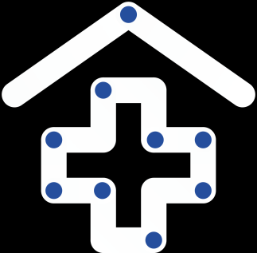
GUVI PROJECT
ONLINE HEALTCARE MANGEMENT
SYSTEM
PRESENTED BY:
Anurag Kumar (23SCSE1010414)
Ayush Maurya (23SCSE1012265)
Harshit Tiwari (23SCSE1010414)
Parth Gupta (23SCSE1012066)

Slide 2
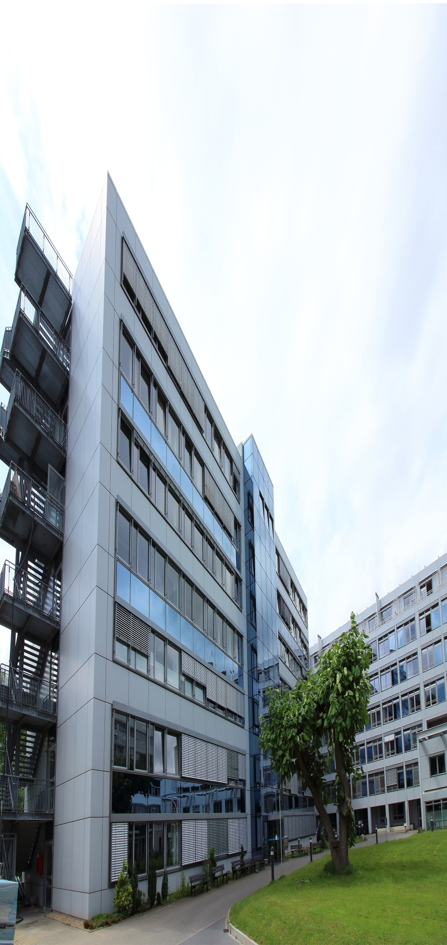
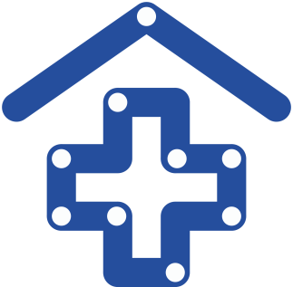

About Us
Who We Are:
We are a team of skilled software developers and engineers with a deep understanding of the healthcare industry. Our goal is to build innovative solutions that empower healthcare providers and enhance patient experiences.
Our Mission:
To create robust, scalable, and user-friendly healthcare management systems that bridge the gap between patients and providers through seamless technology.
What We Do:
We develop comprehensive software solutions that streamline healthcare processes—from appointment scheduling and telemedicine to managing electronic health records (EHR) and billing systems. Our focus is on delivering secure, efficient, and reliable platforms.
Our Vision:
To lead the digital transformation of the healthcare industry by providing intelligent and flexible solutions that adapt to the evolving needs of healthcare providers and patients worldwide.

Slide 3

HEALTH CARE MANAGEMENT SYSTEM
Your health, our priority. Compassionate care, innovative solutions—because your well-being is the heart of our mission.

Slide 4
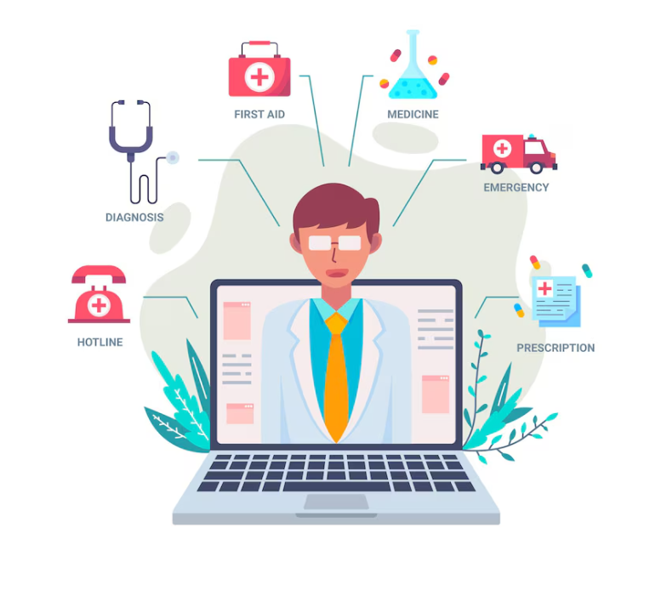

PURPOSE OF THE PROJECT
Streamline Health Records: Make it easy for patients and doctors to access and manage health records.
Improve Communication: Facilitate better communication between patients and healthcare providers.
Enhance Patient Engagement: Encourage patients to take an active role in managing their health.
Increase Efficiency: Reduce paperwork and make healthcare processes faster and more efficient

Slide 5

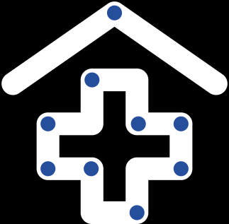
Our Services
we are dedicated to providing comprehensive healthcare services tailored to meet the diverse needs of our community. Our services include:
Appointment Scheduling:
Electronic Health Records (EHR) Integration:
Patient Portals:
Our system enables seamless online booking and management of appointments, with real-time availability and automated reminders.
We build secure, centralized EHR systems to store and manage patient data, ensuring easy access for healthcare professionals and patients alike.
Our system includes personalized dashboards for patients to access their medical records, communicate with doctors, and manage their health data.
01
02
03

Slide 6
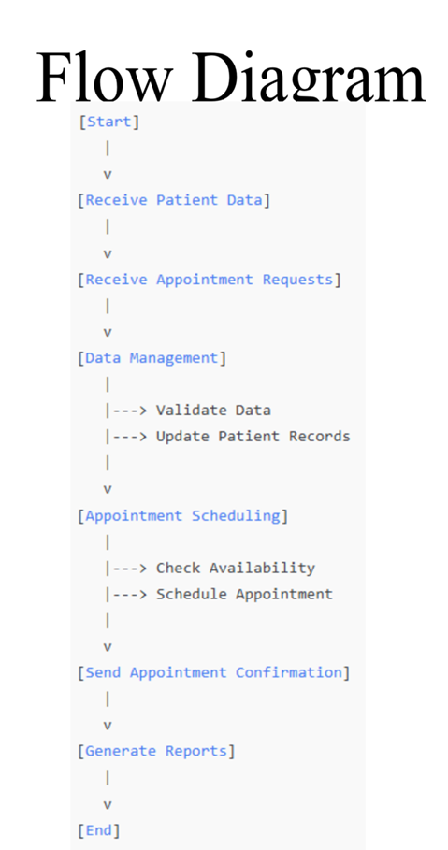
FLOW DIAGRAM

Slide 7
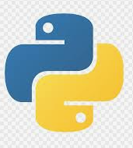



Technology Used to Develop the PROJECT
Web Development
Backend Development:
02
Languages like Python or Java for managing server-side logic
01
HTML, CSS, and JavaScript for creating user-friendly interfaces
Database: MySQL
for secure data storage and retrieval
03

Slide 8
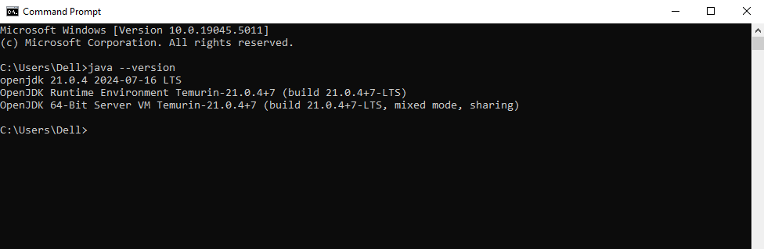
JDK & IDK SETUP
Languages like Python or Java for managing server-side logic
HTML, CSS, and JavaScript for creating user-friendly interfaces
for secure data storage and retrieval

Slide 9
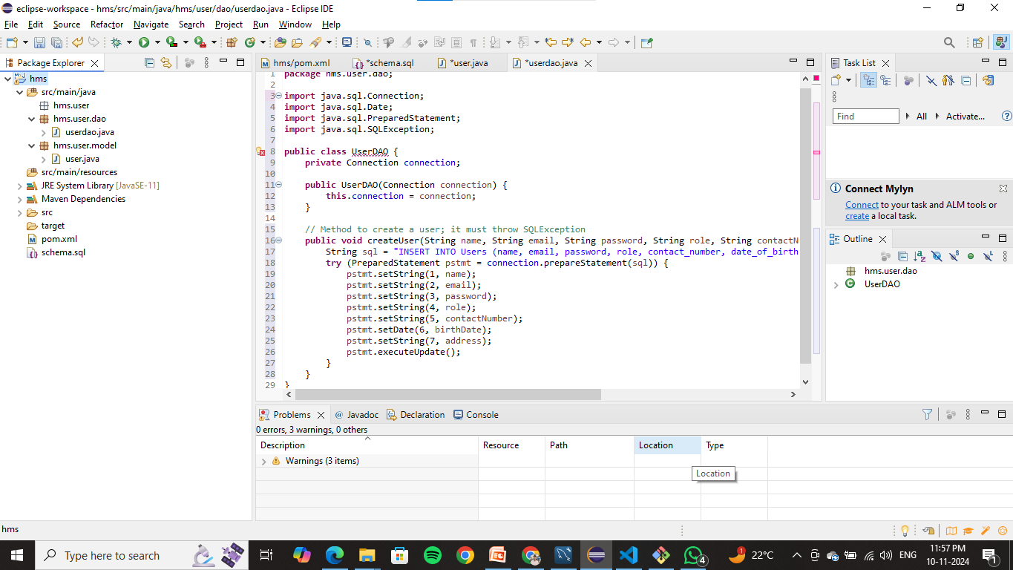
PROJECT STRUCTURE
Languages like Python or Java for managing server-side logic
HTML, CSS, and JavaScript for creating user-friendly interfaces
for secure data storage and retrieval

Slide 10

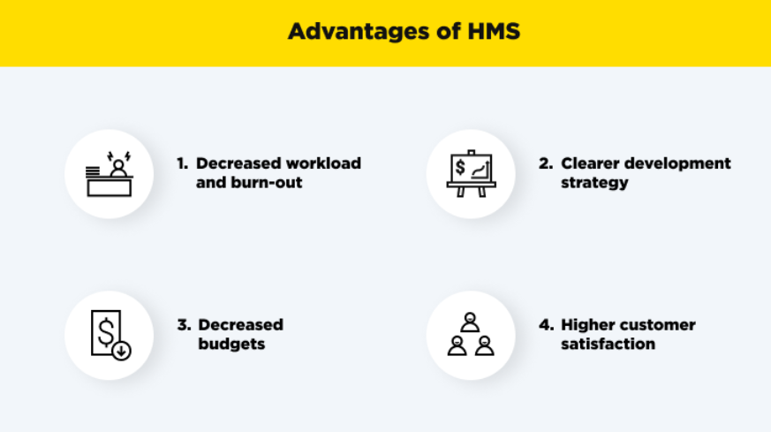
Summary of the Project
The Online Health Management System is designed to simplify how patients and doctors interact.
It allows easy access to medical records, appointment scheduling, and health monitoring.
By using modern technology, we ensure that the system is secure, efficient, and user-friendly.
Ultimately, it aims to improve health outcomes by making healthcare more accessible and manageable for everyone.

Slide 11
Thank
You

